Slide 1

Emotions Predictions From text in Emotion Dataset
CS616 Project 3
By AAV Group

Slide 2
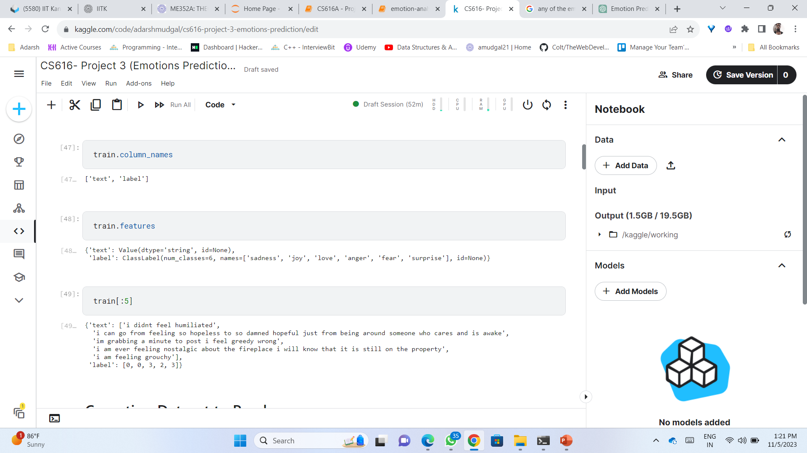
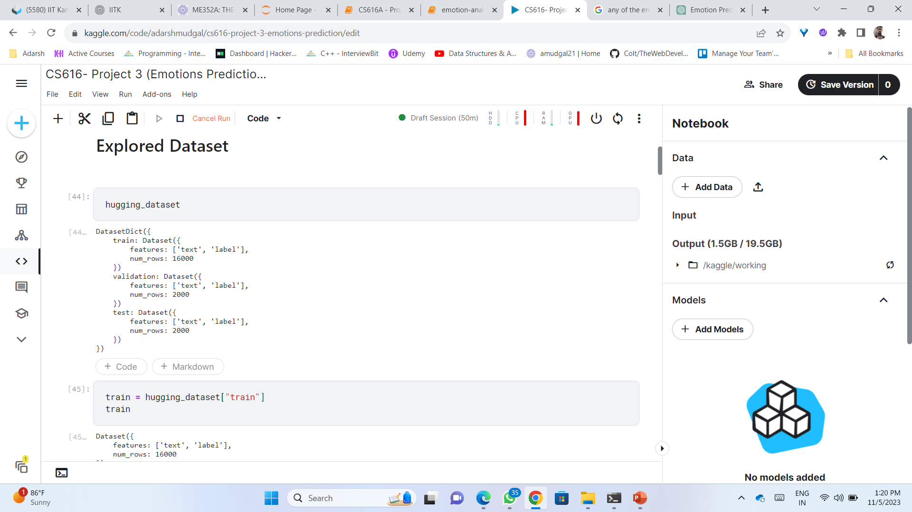
Dataset Overview

Slide 3
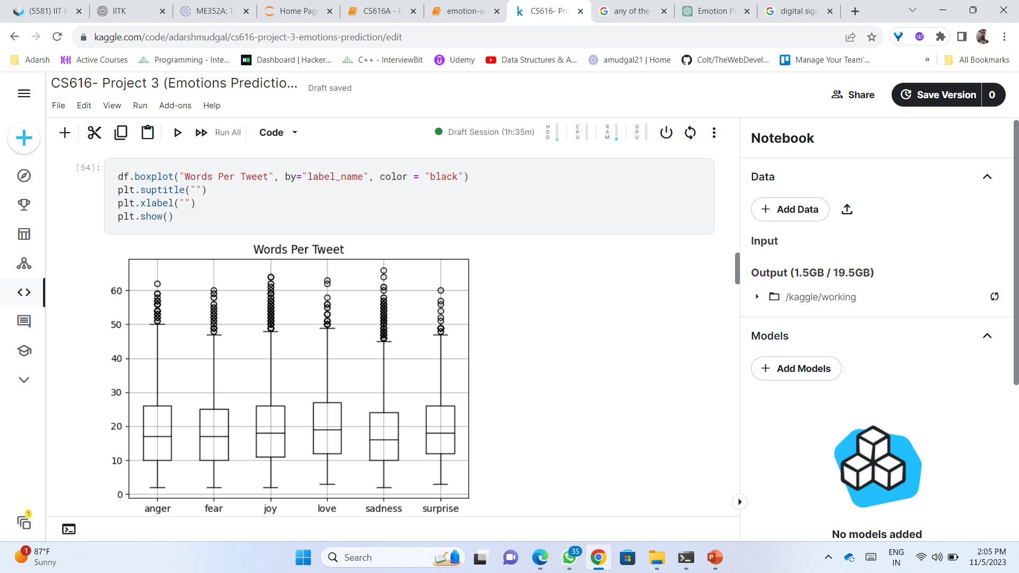
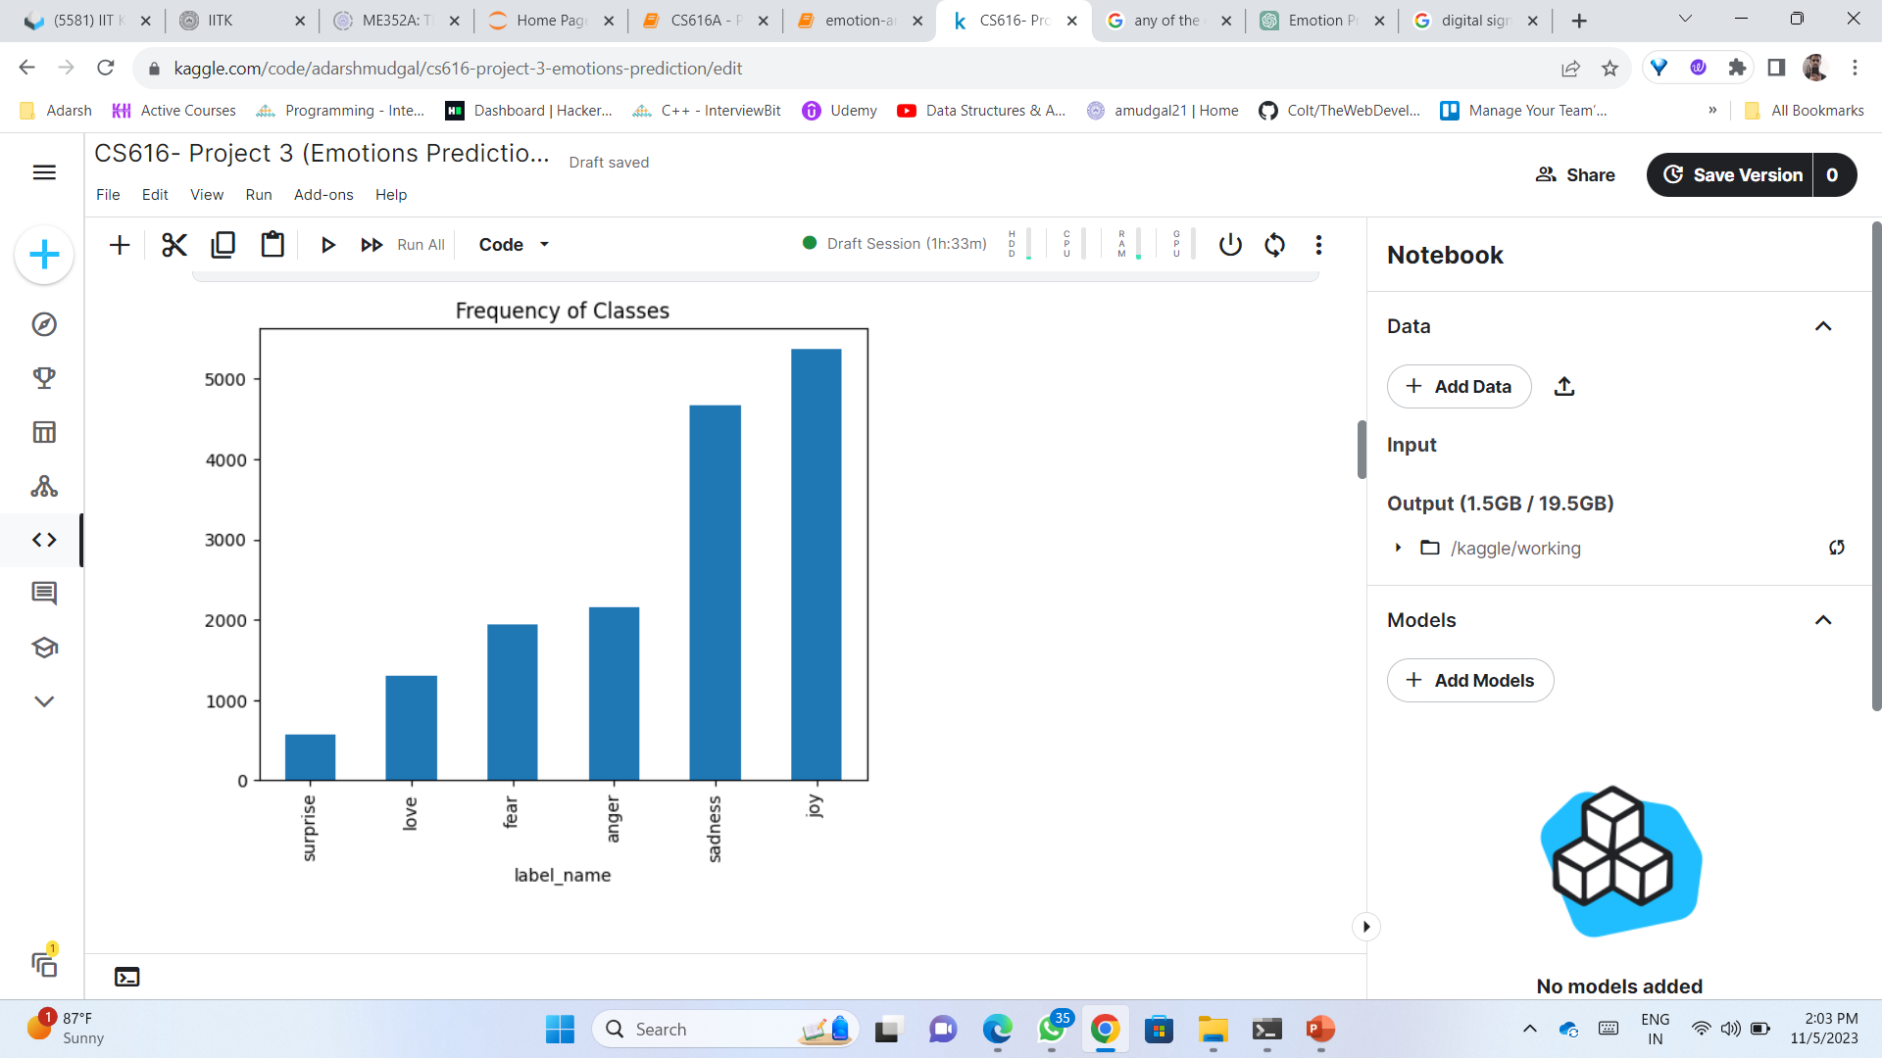
Dataset Visualisation
Converting Dataset to Pandas: To visualize and analyze the data more conveniently.

Slide 4
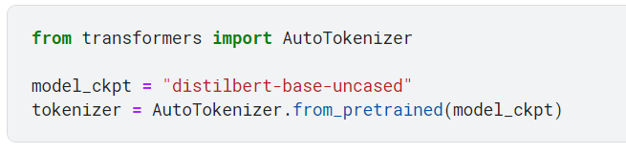
Data Pre-processing:
Tokenization: Tokenized the text using pre-trained DistilBERT tokenizer from Hugging Face’s transformers .
Encoding Text: Transformed these tokens into numerical representations suitable for model input, so that it can process for training model.

Slide 5
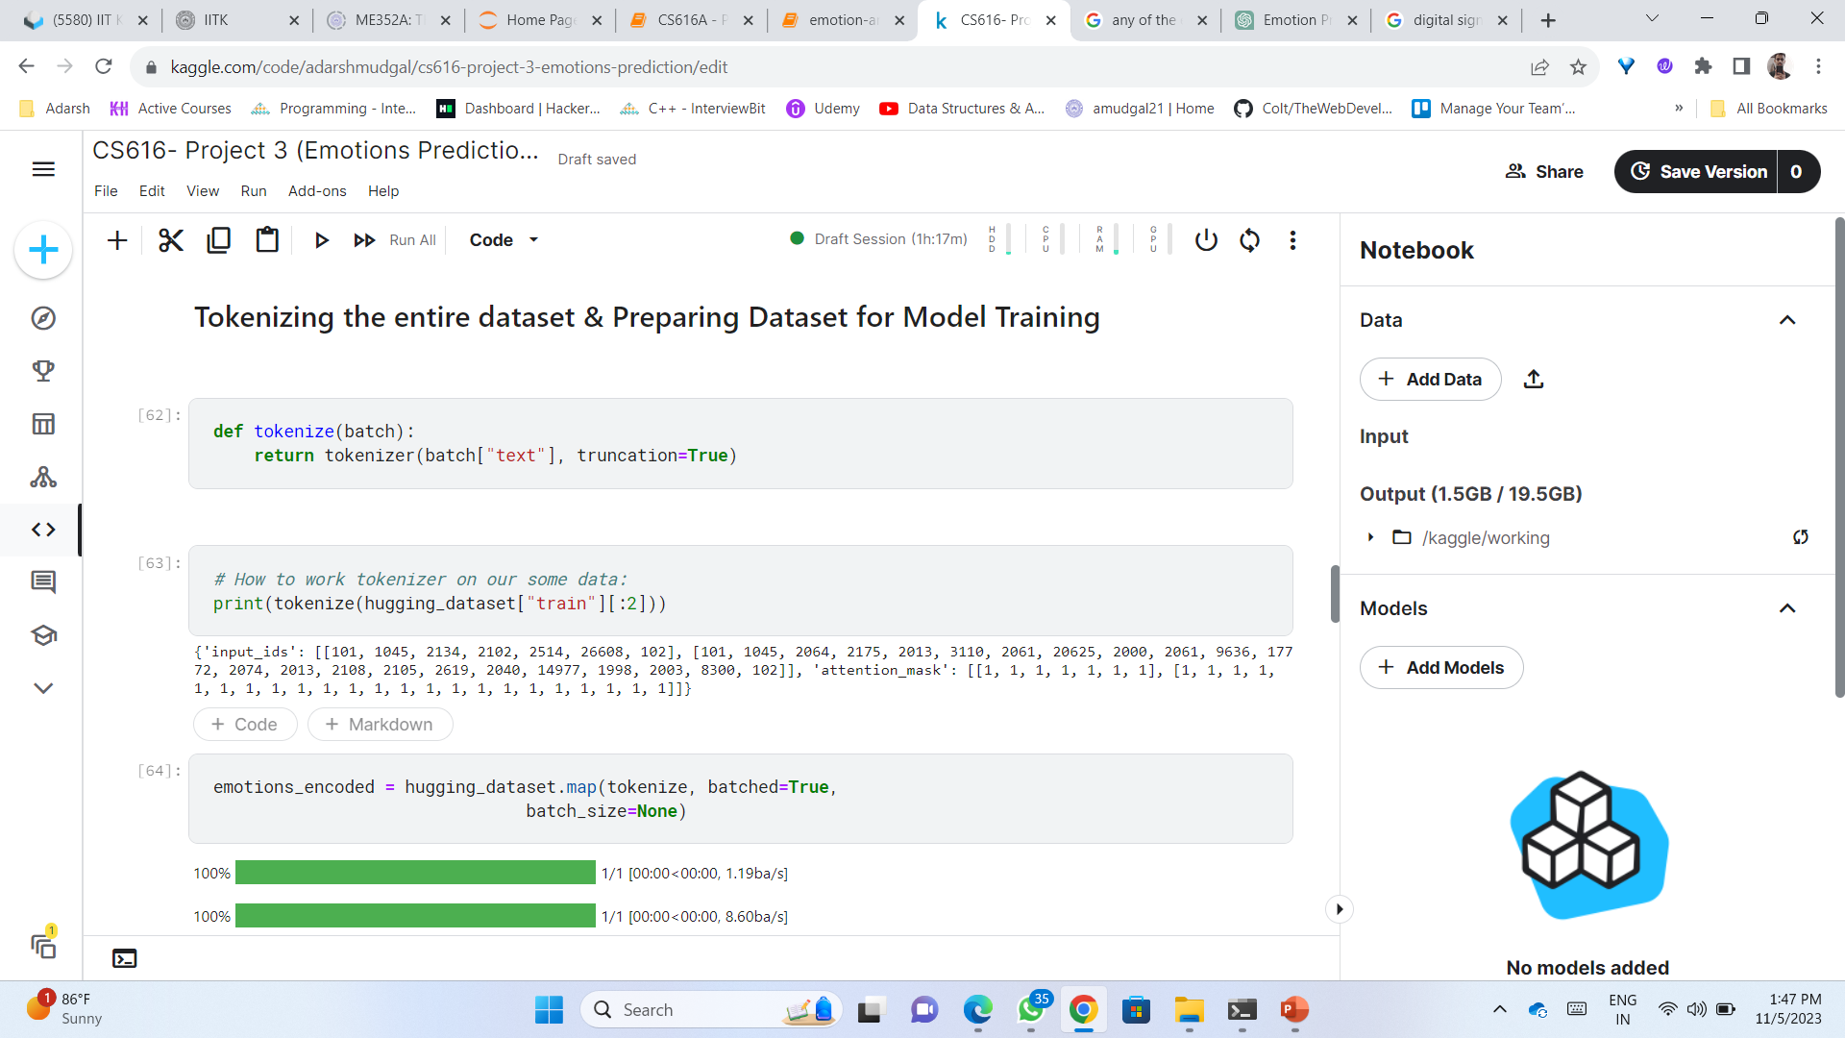
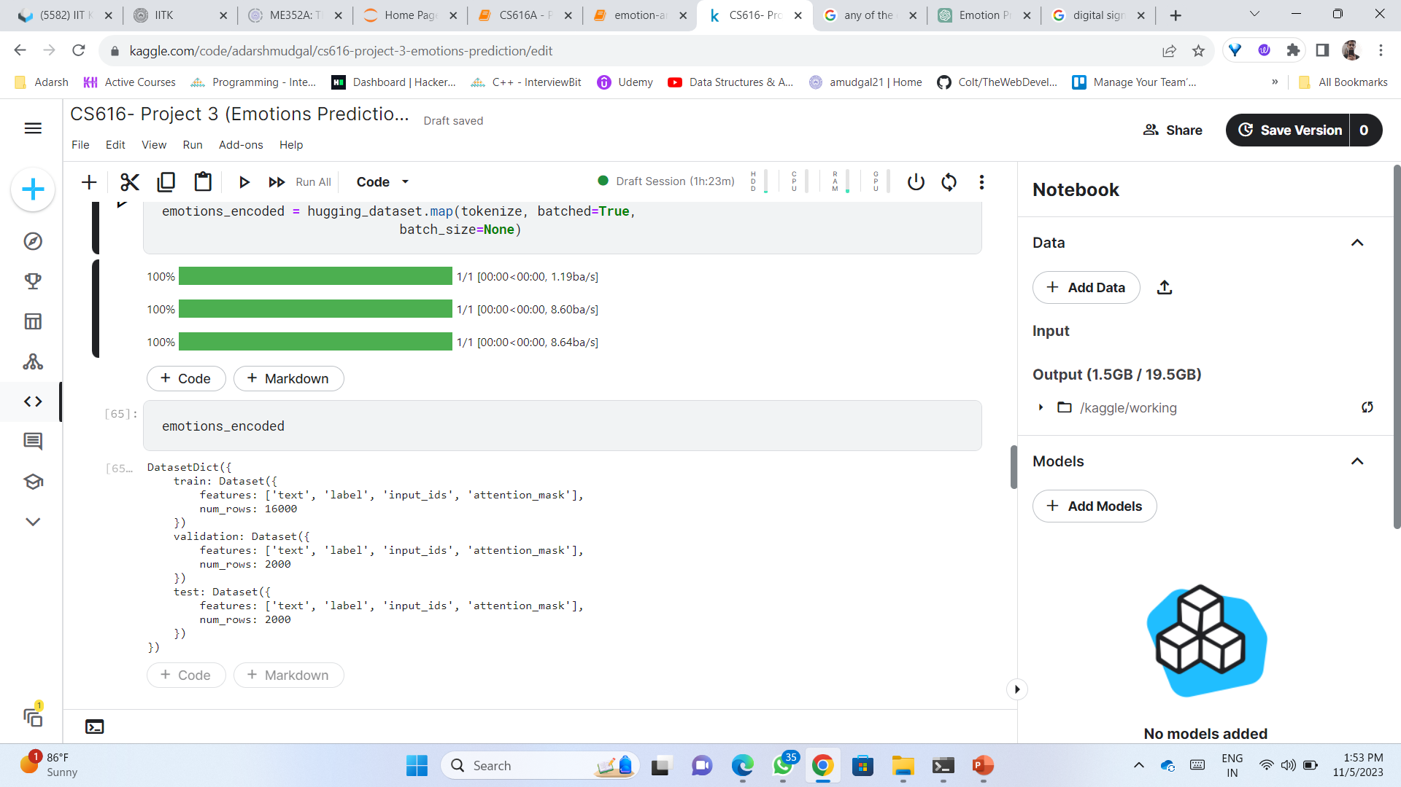

Slide 6
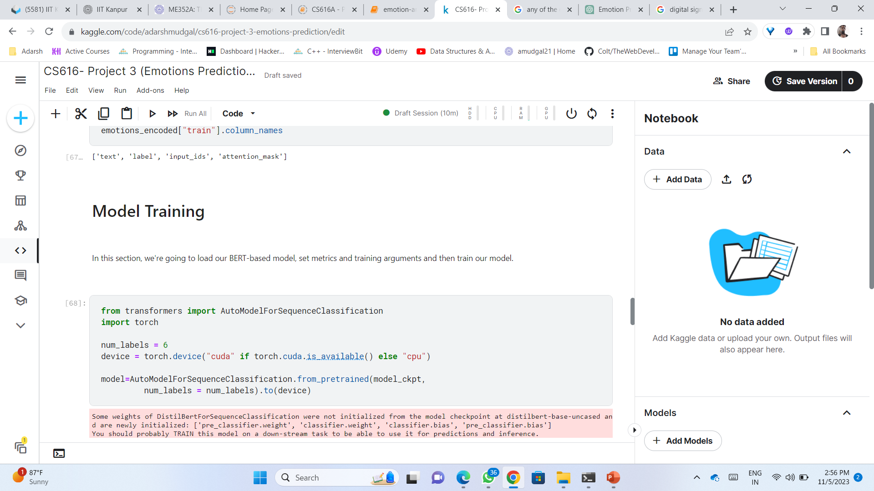
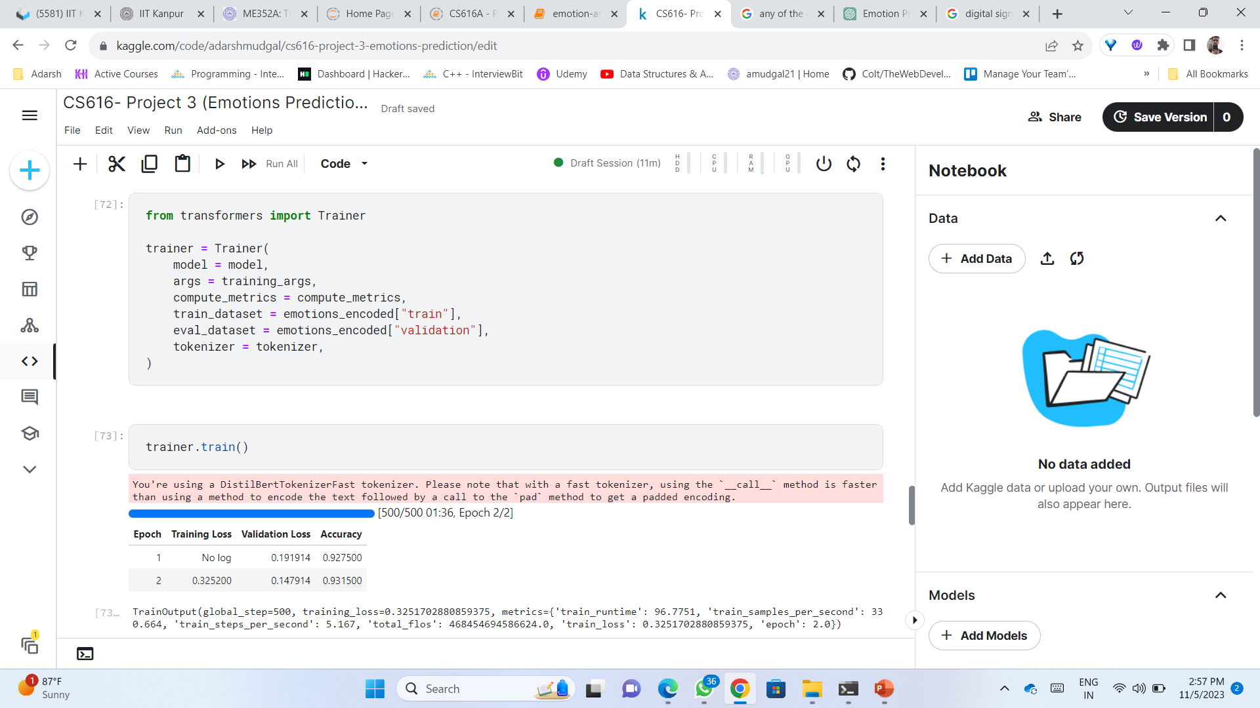
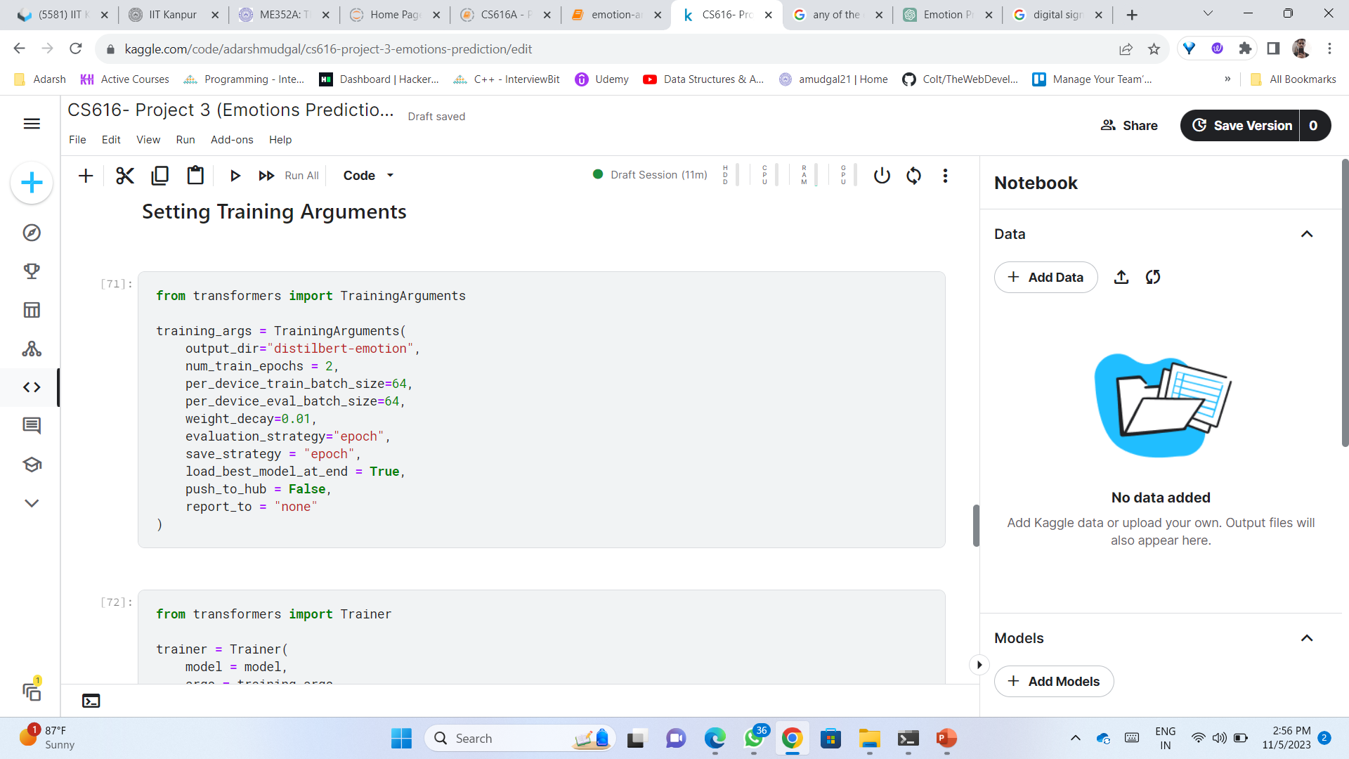
MODEL TRAINING

Slide 7
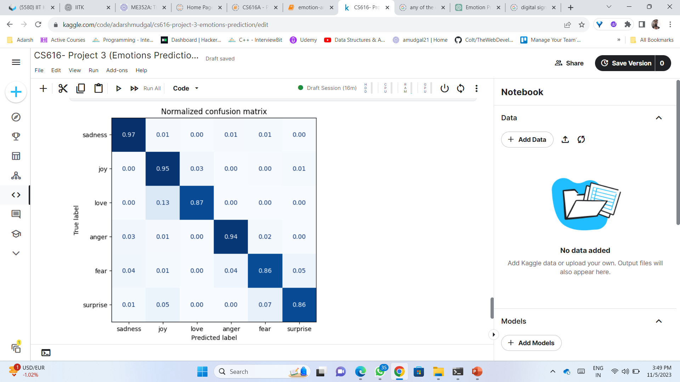
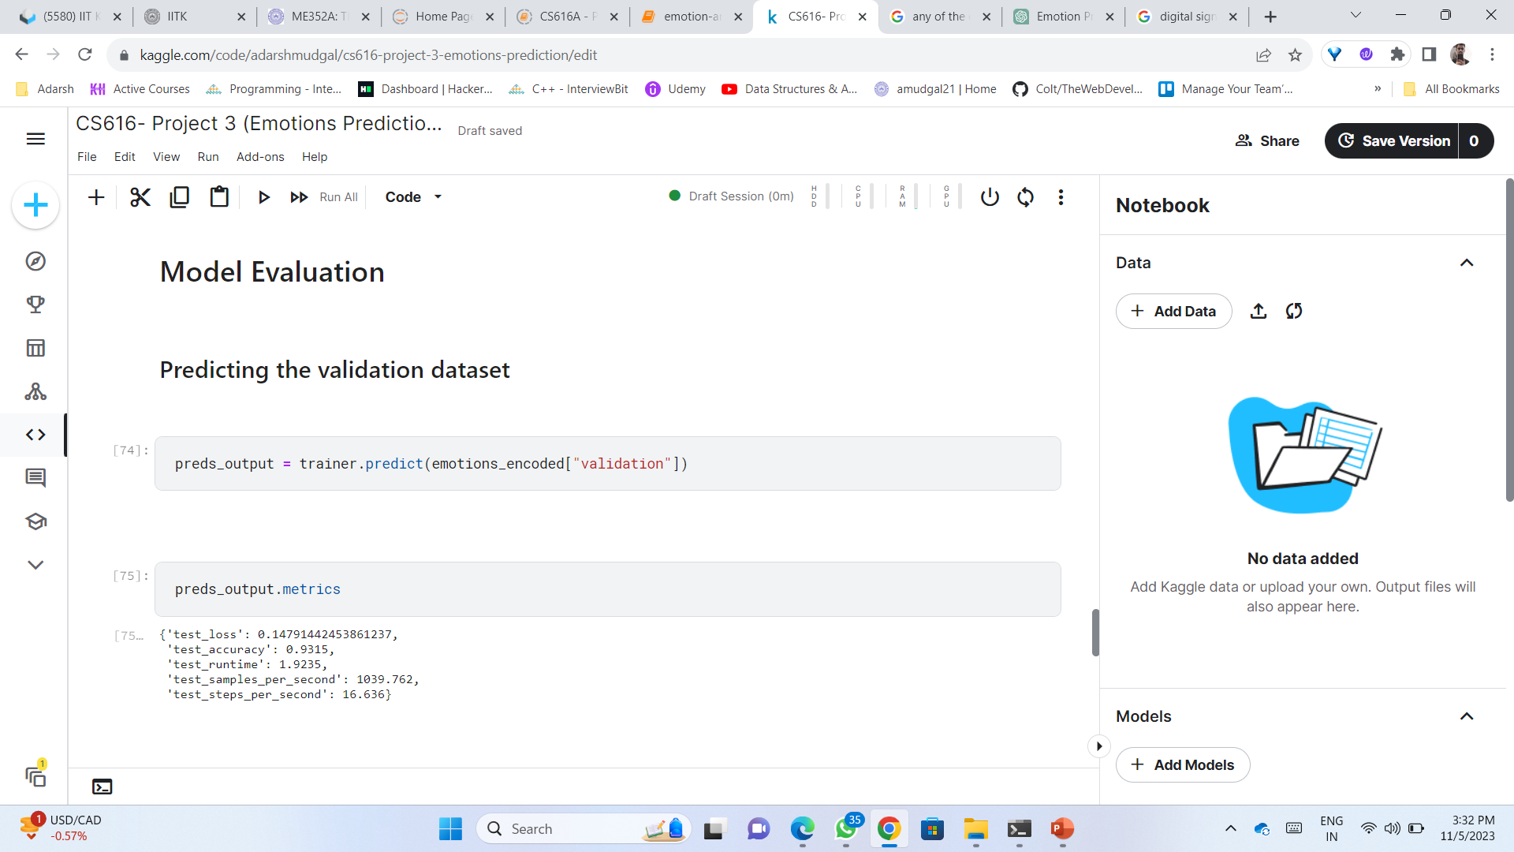
Model Evaluation

Slide 8
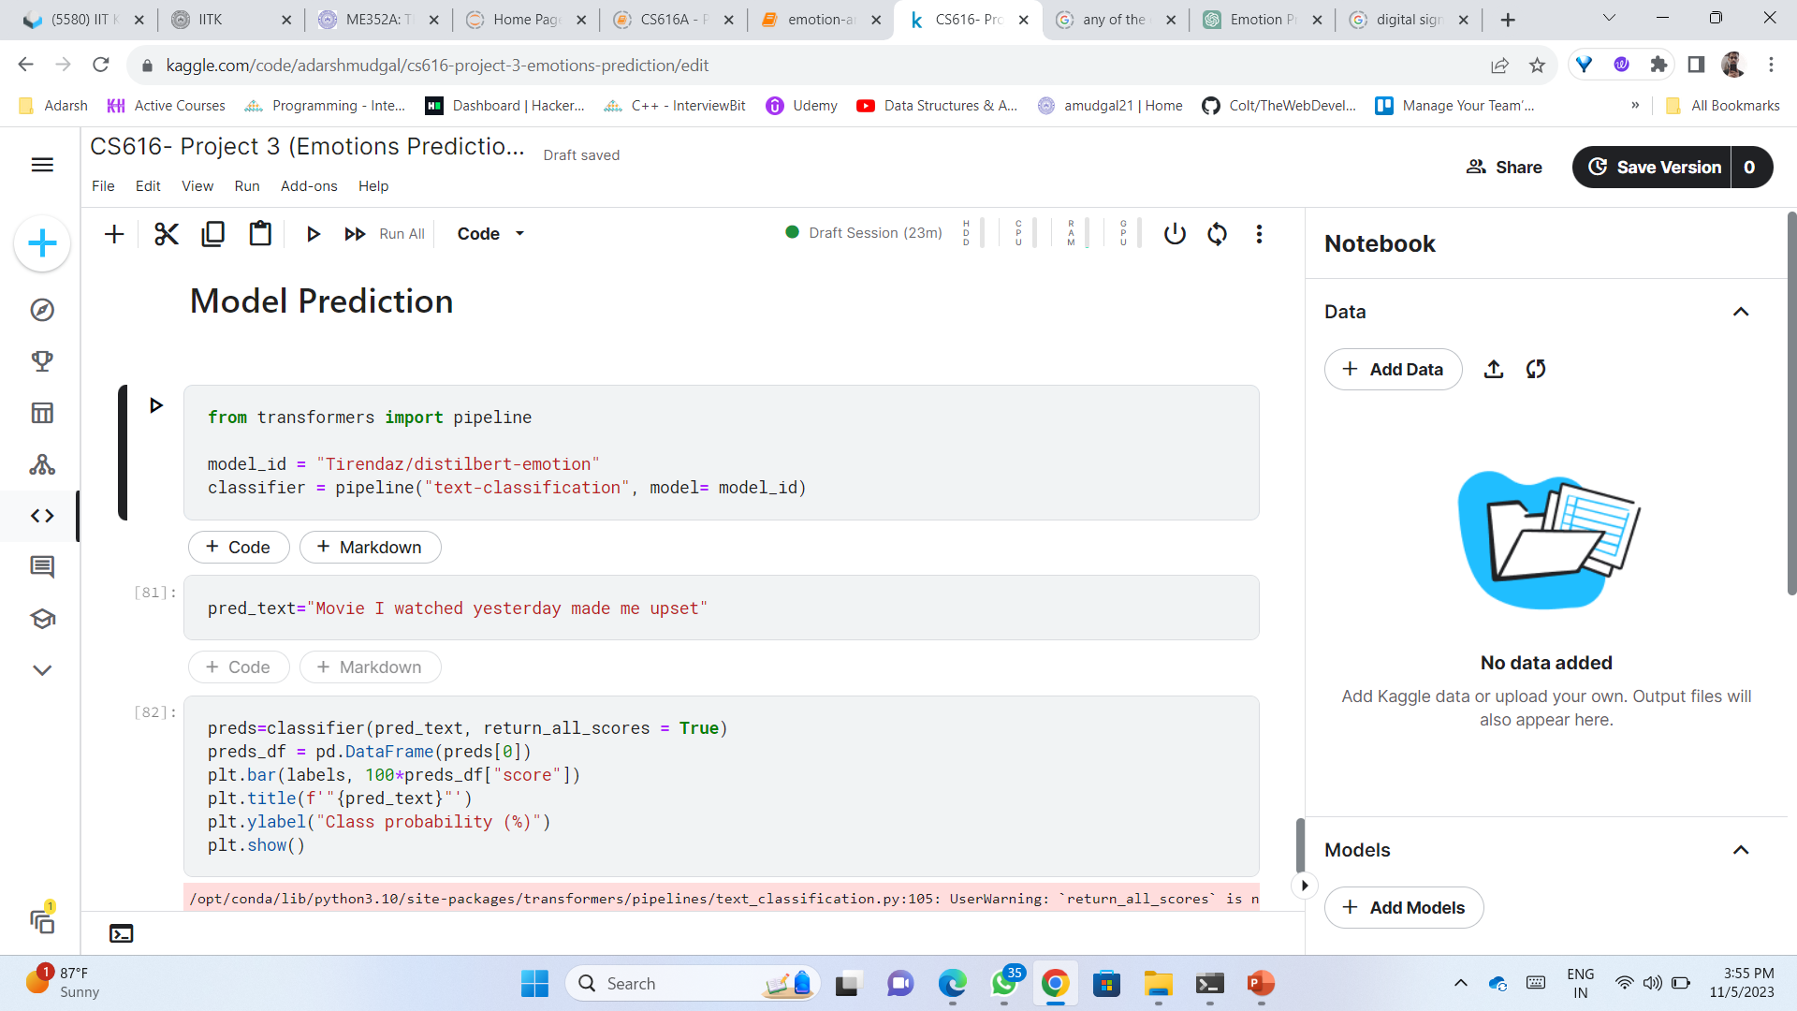
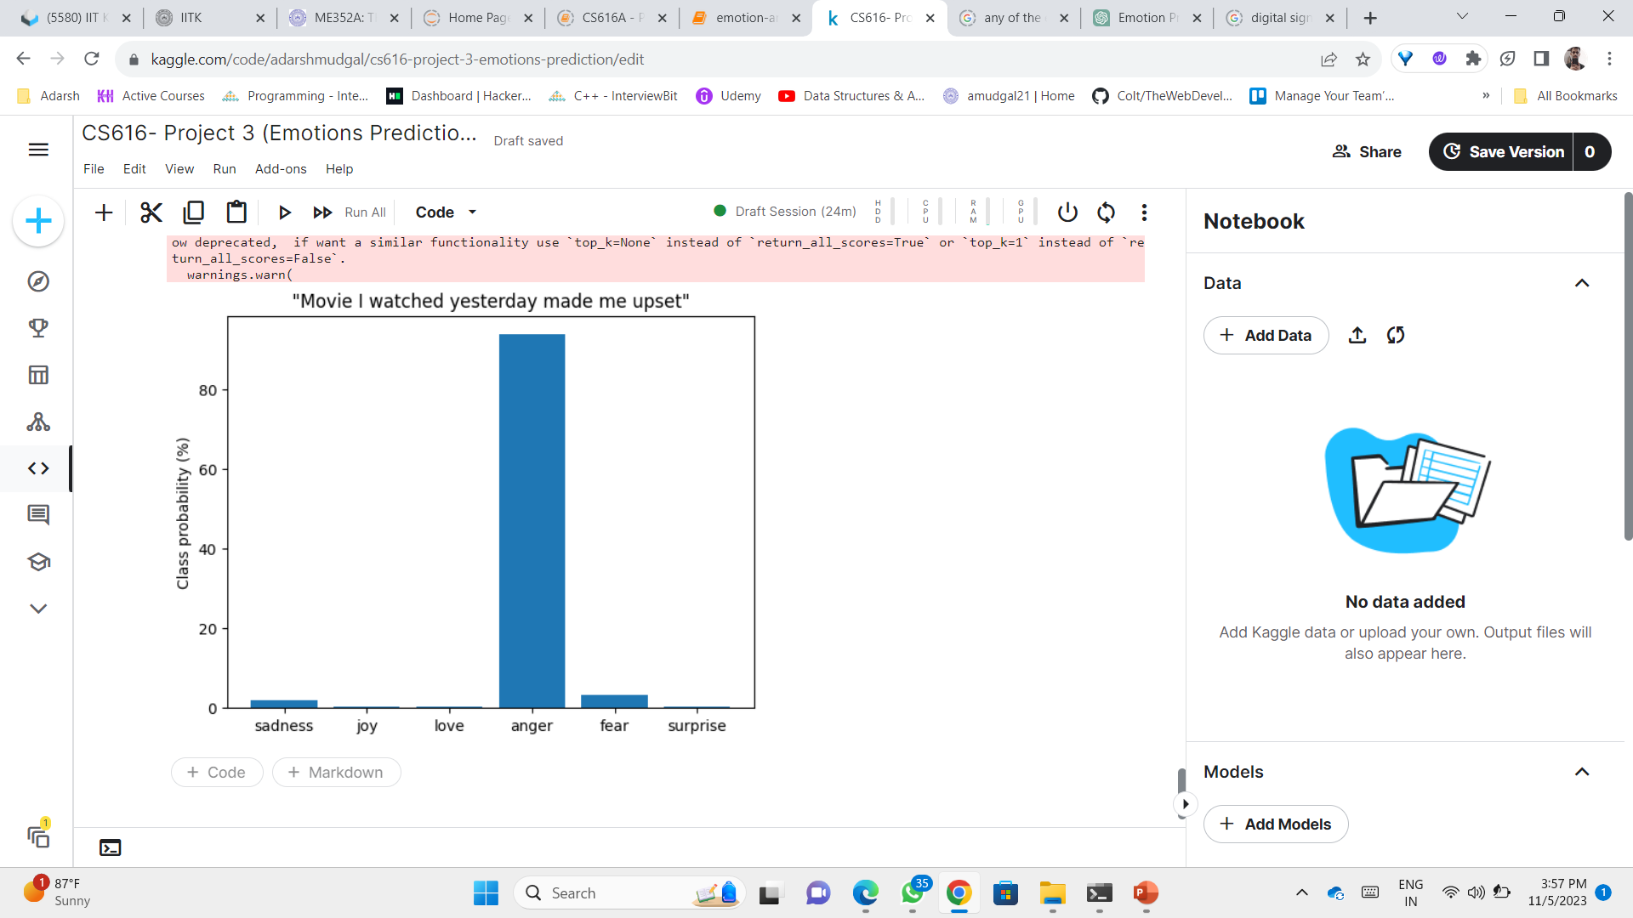

Slide 9
Thank you

